Slide 1

Wine Tasting Analysis
TEAM:
Lilit Akopyan
Arlen Navasartian
Anna Liang
Alex Dingkuo Chiang

Slide 2
About this Analysis:
We chose to analyze worldwide professional wine evaluations in 2017.
Questions:
Is there correlation between wine price points and their overall ratings?
Which countries produce the most wine that is up for evaluation?
Are certain varieties of wine reviewed higher than others? (i.e. does Pinot Noir have generally higher rating than a Cabernet?)
Does the year of wine made (aging process) play any factor in the price or rating of a wine?

Slide 3
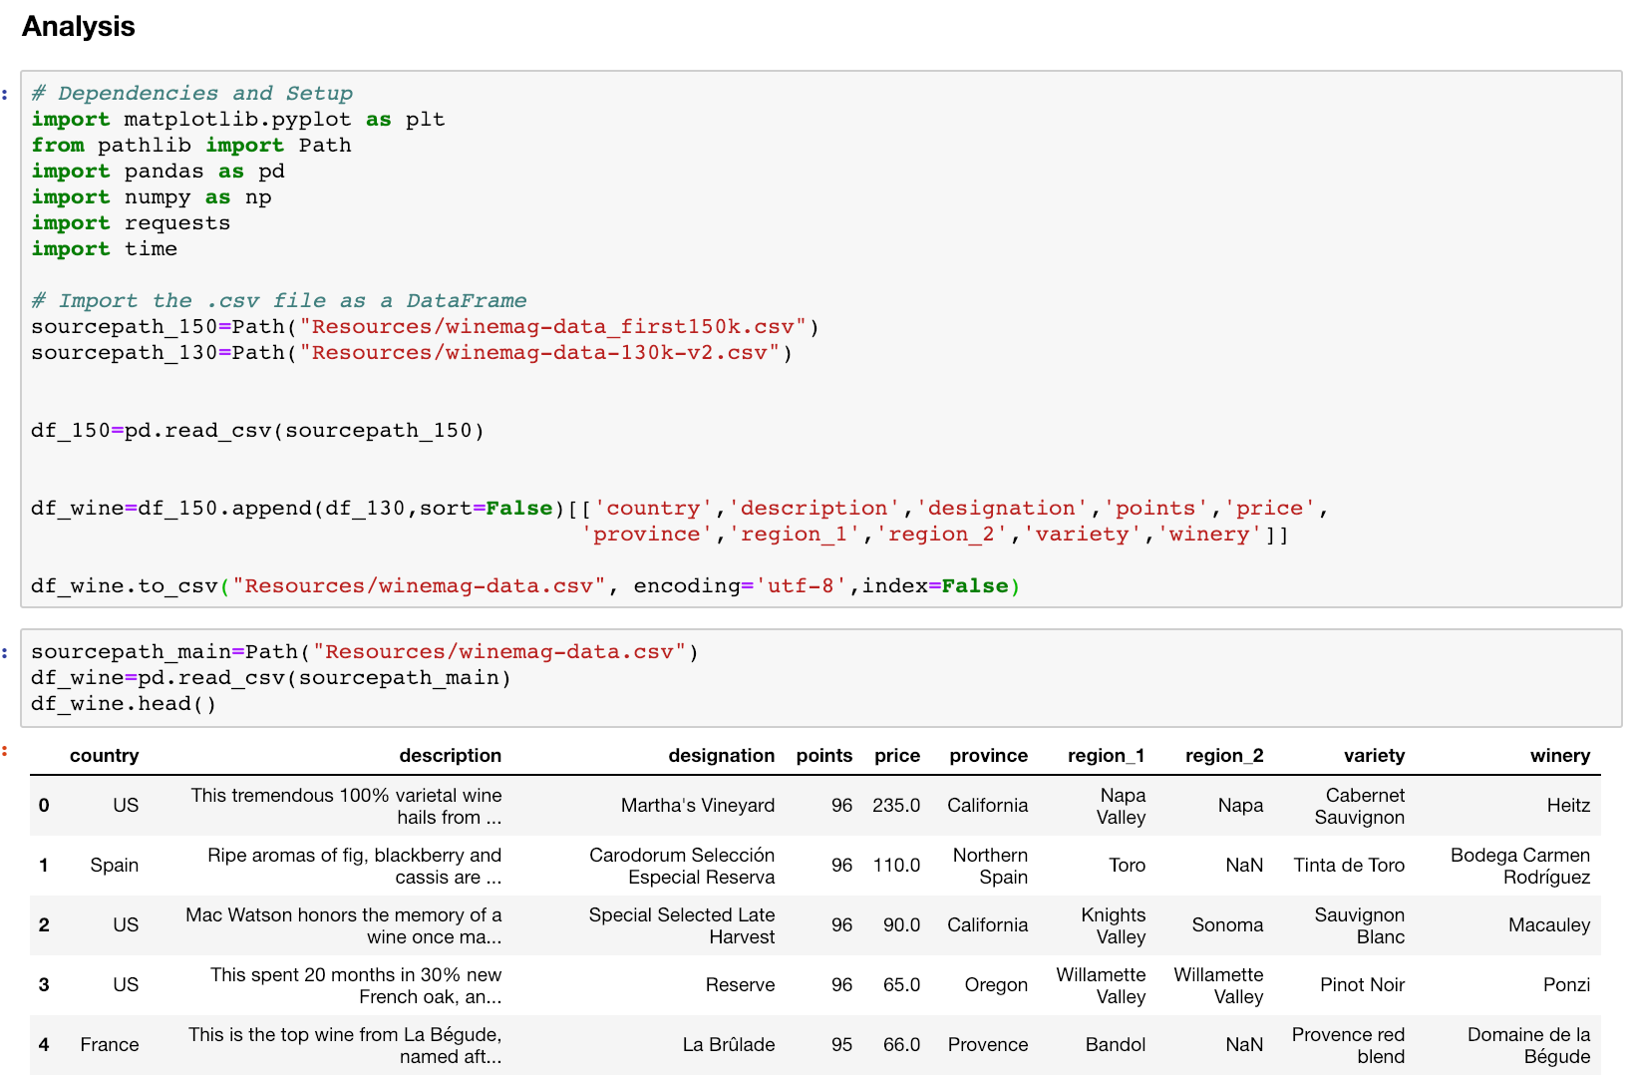
The Clean Up Process:
Began with importing two large csv files then appending the two on their common data points.
Created a single file to use in further analysis with the key points seen to the left.
This file will be used primarily in our geographical analysis of the data.

Slide 4
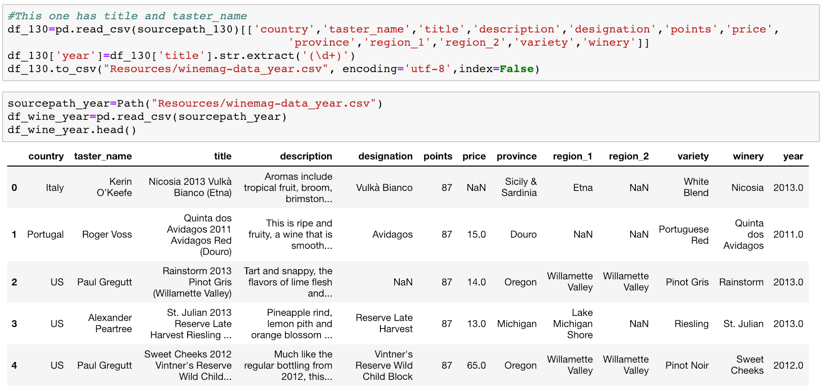
The Clean Up Cont’d:
One of the datasets that we used in the prior appendage had more detailed key points that we wanted to use in our analysis such as the taster_name and title.
We noticed that every title includes the year of the wine, so we extracted the year from the title and displayed it as its own column to perform analysis on.

Slide 5
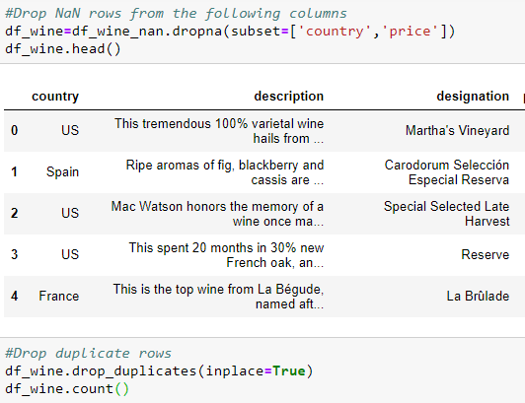
Location Based Analysis
We are going to analyze the geolocation of country and province or state that the wine is from
to see if there is a correlation between location and price/points.
We started with a little bit of clean up.

Slide 6
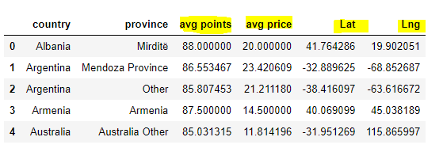
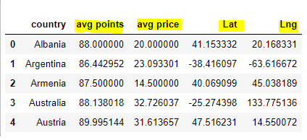
We grouped by country and province to get the mean of points and prices then we ran through google geocoding api to find out the lat/lon of each wine location.
We also grouped by country to get the mean of points and prices then we ran through google geocoding api to find out the lat/lon of each wine location.

Slide 7
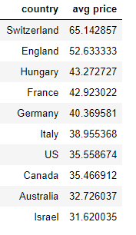
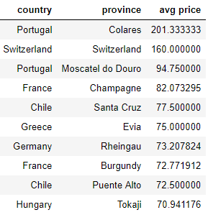
Top 10 expensive wines by province vs country

Slide 8
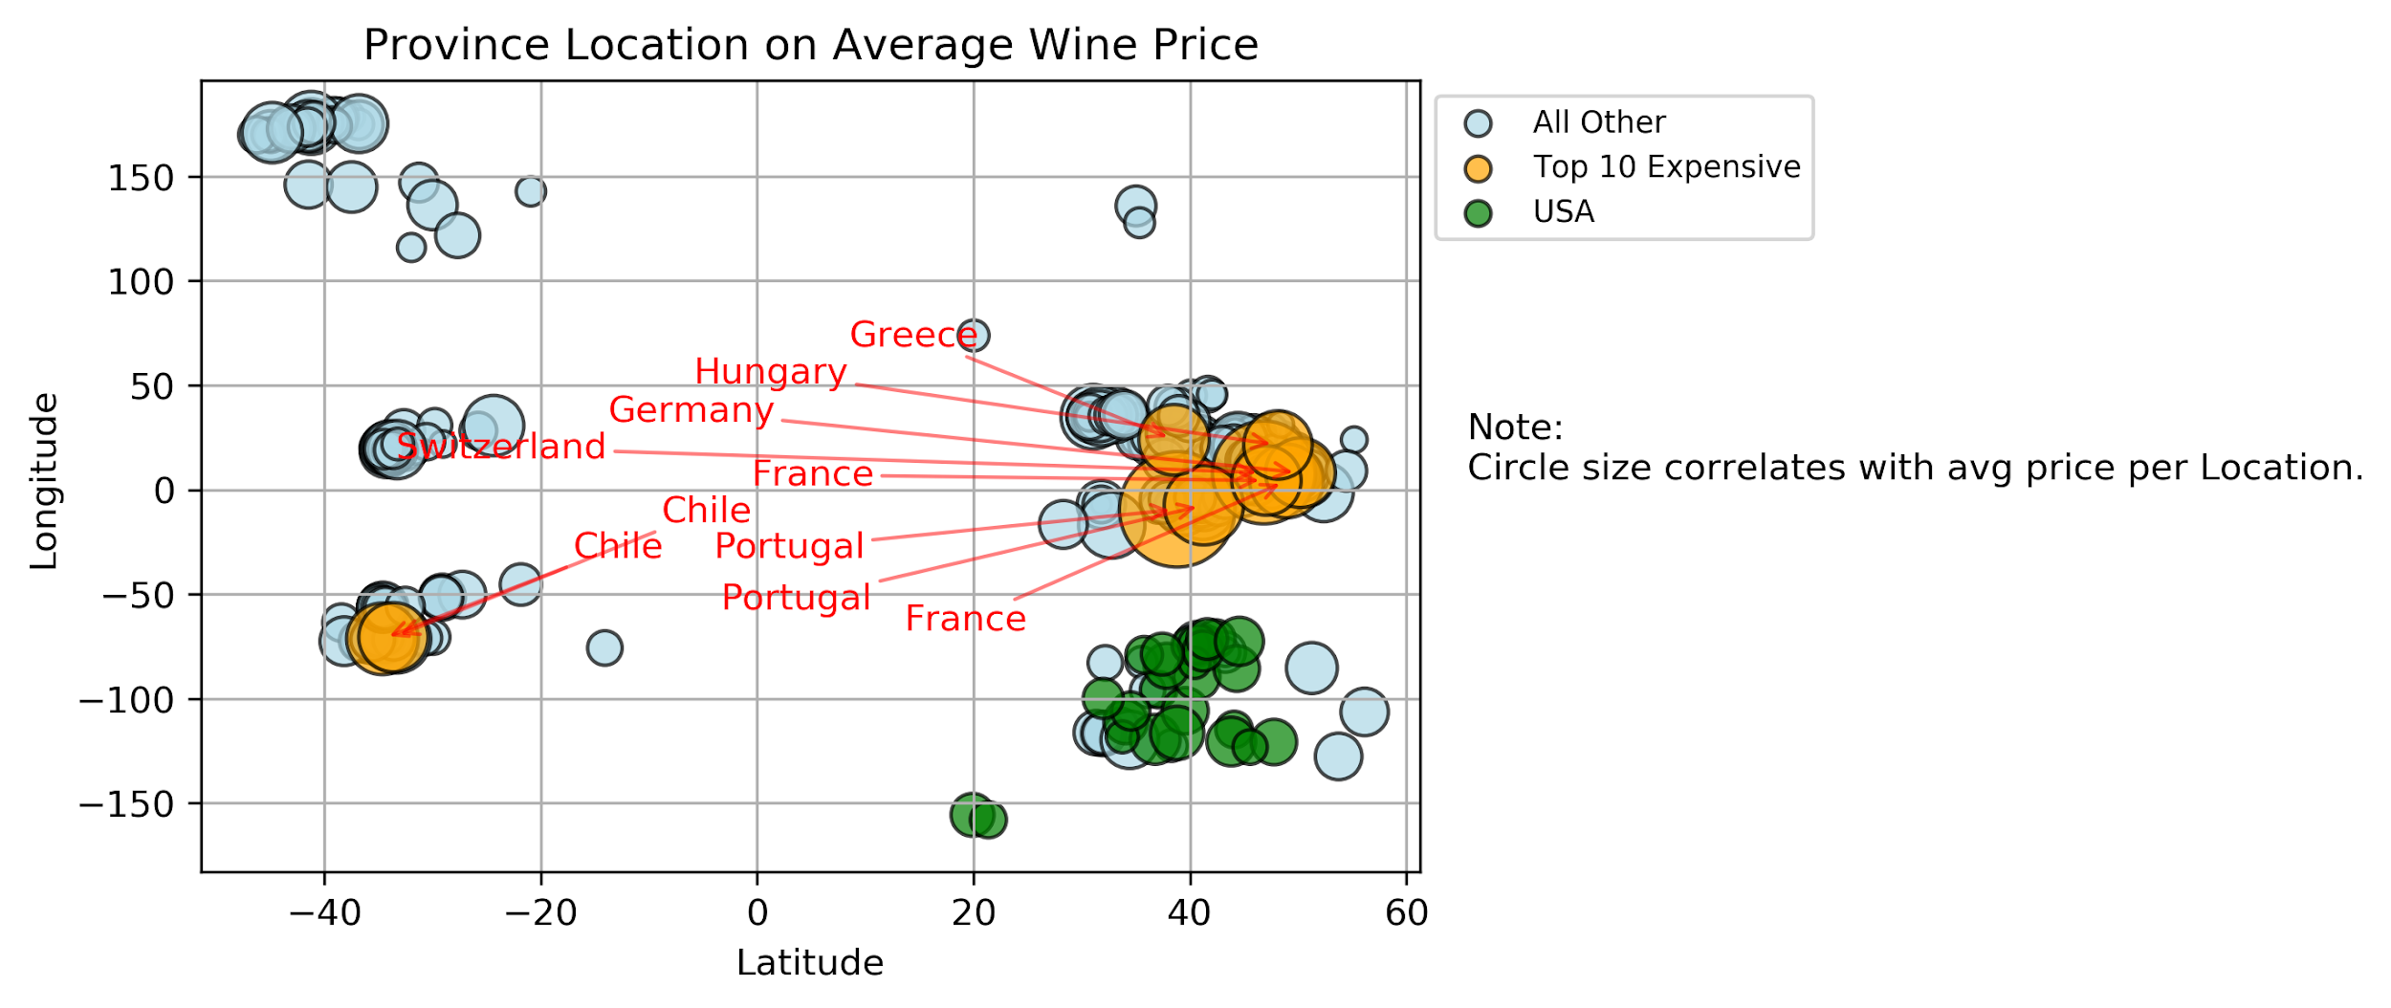
Scatter plot by province/state
Finally we did the scatter plot on three datasets.The Top 10 most expensive, US wines and the rest as follows. As you can see, Europe holds the majority of produced expensive wines.

Slide 9
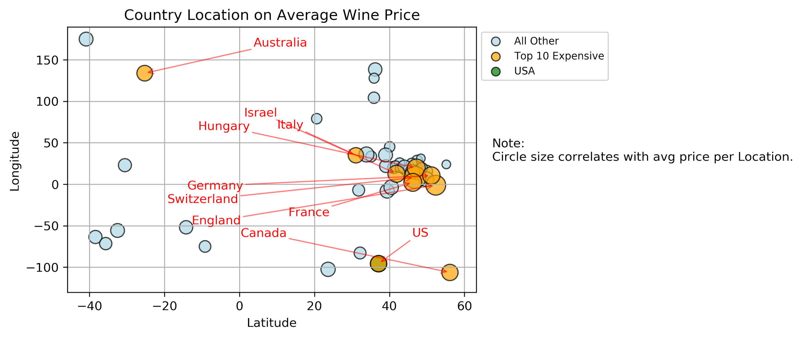
Scatter plot by country

Slide 10
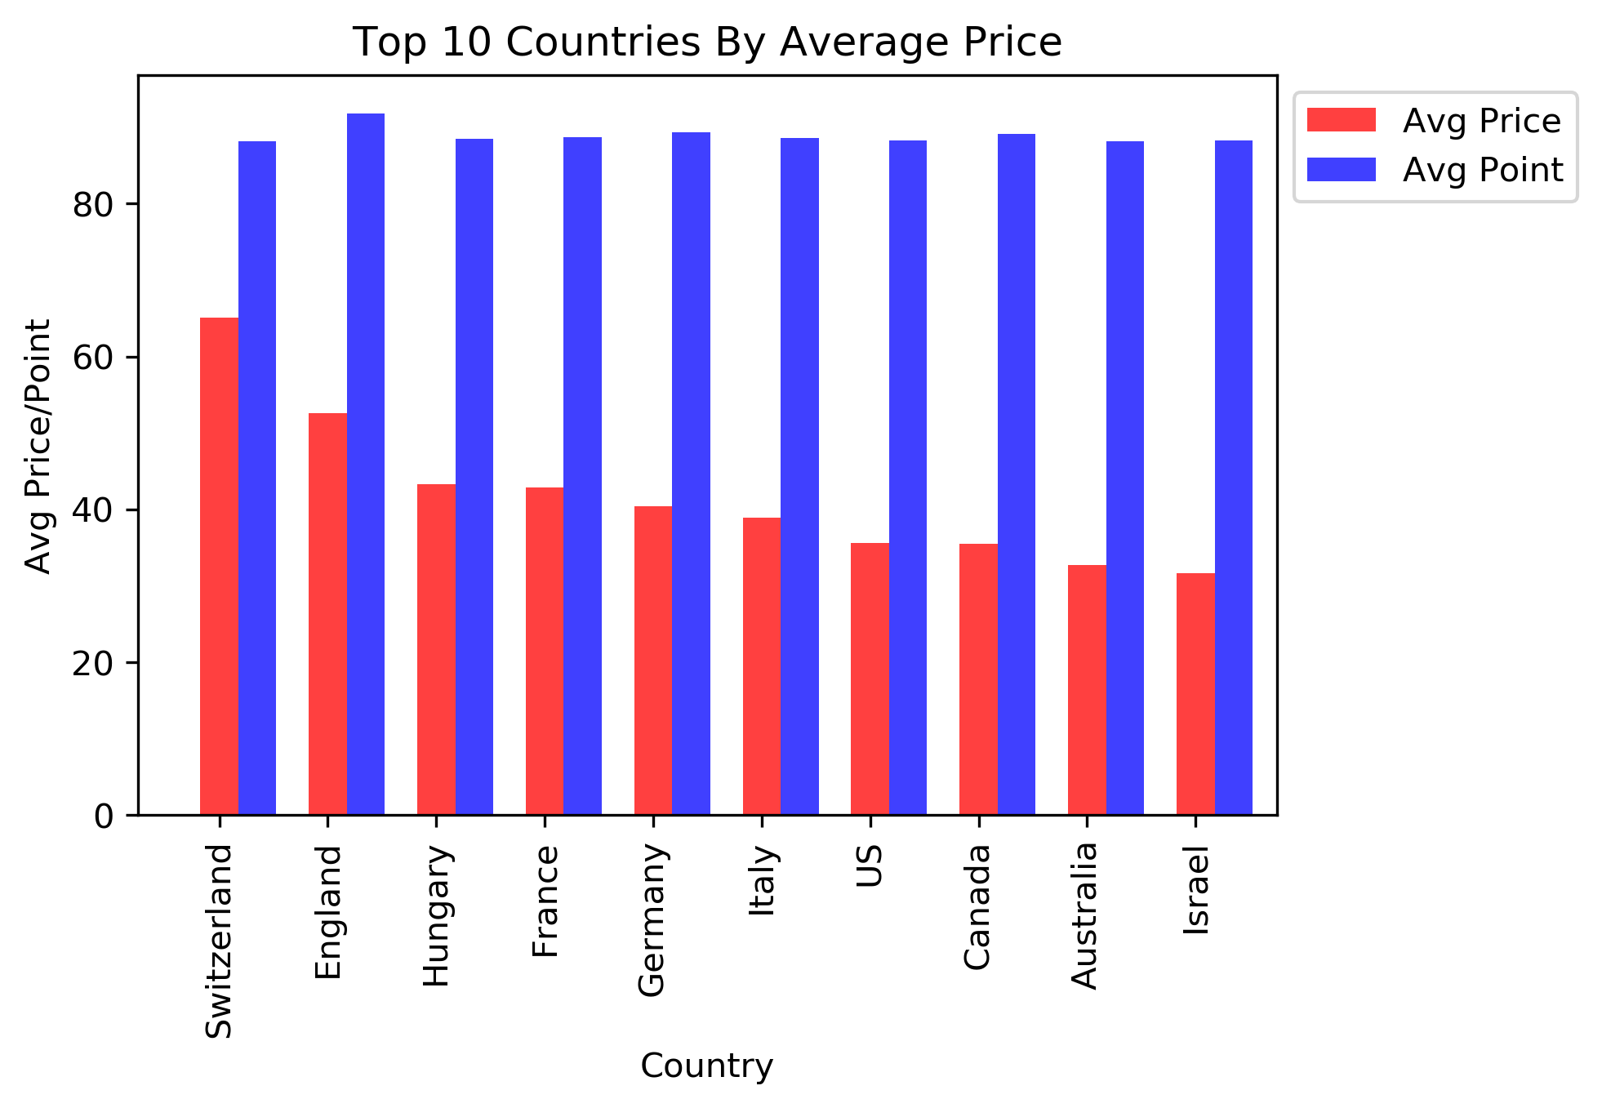
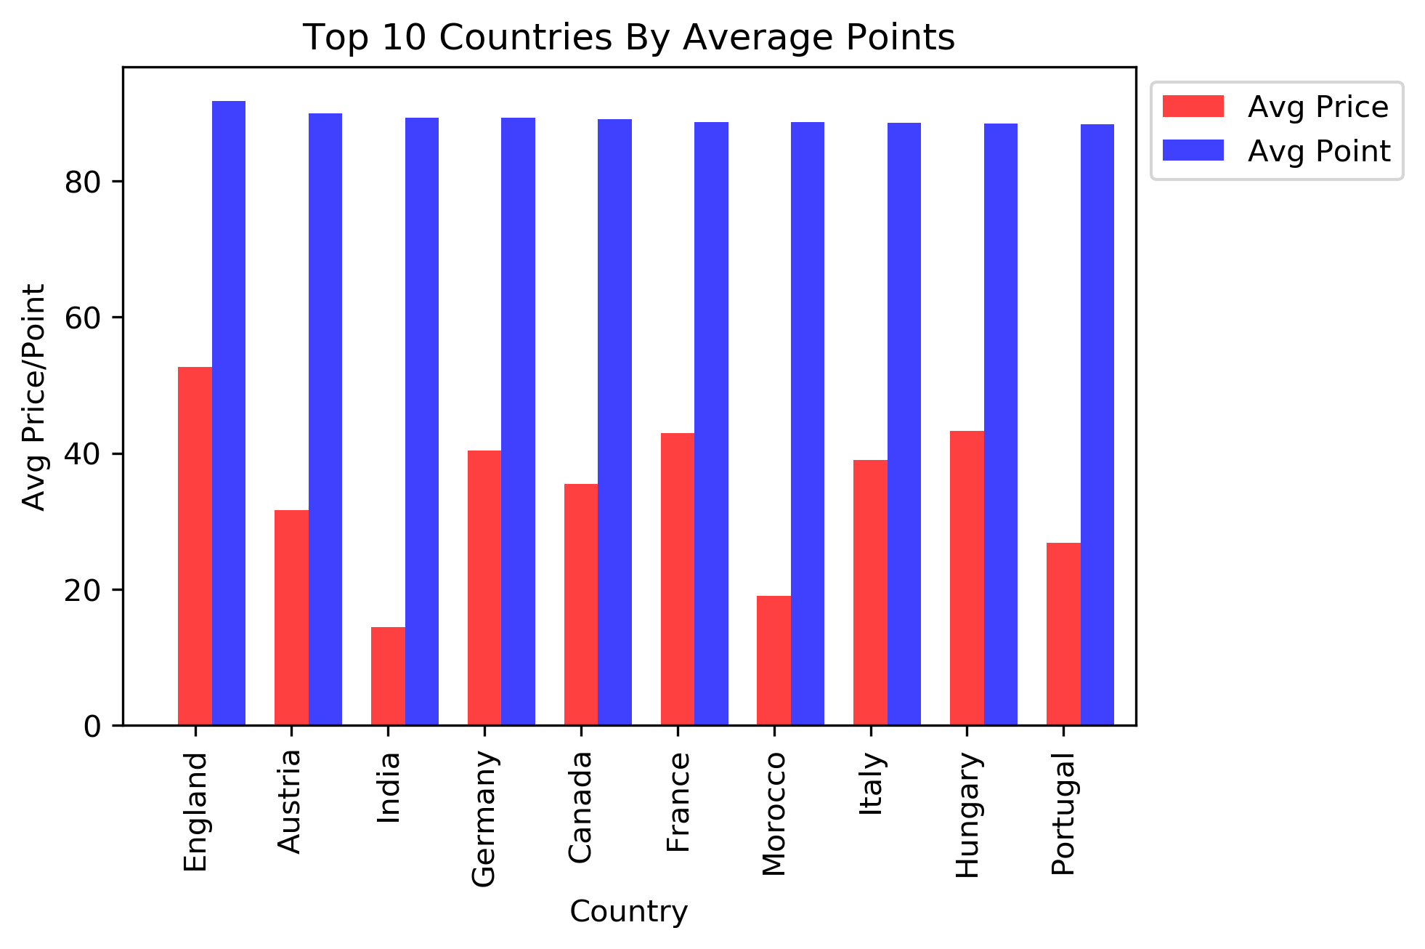
As you can see these two bar charts, there is no correlation between points and price.
Higher pricing does not necessarily mean higher rating among different countries.

Slide 11
We did another analysis based on the quality of the wine and average price.
Wine Spectator tasters review wines on the following 100-point scale:
95-100 Classic: a great wine
90-94 Outstanding: a wine of superior character and style
85-89 Very good: a wine with special qualities
80-84 Good: a solid, well-made wine
75-79 Mediocre: a drinkable wine that may have minor flaws
50-74 Not recommended
points_bins = [80,85,90,95,100]
group_names = ["Good", "Very good", "Outstanding", "Classic"]

Slide 12
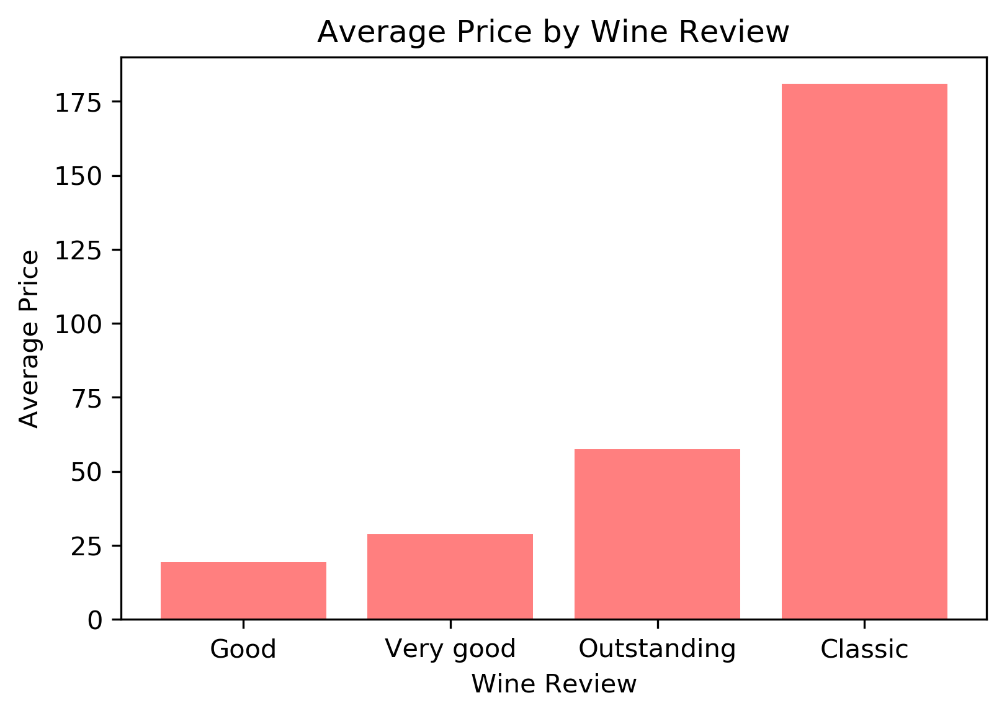
As you can see the quality of the wine has a direct correlation with the price.
The higher the quality, the higher the prices

Slide 13
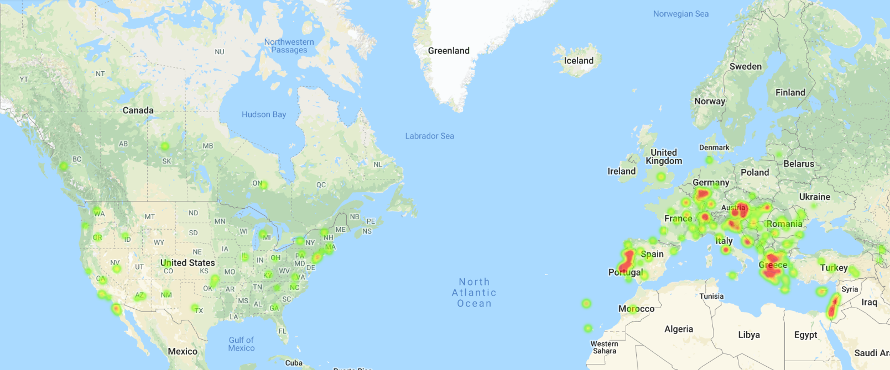
Heat map of average price by country and province
Price scale from green to red for low to high.
Higher average prices scatter in Europe.

Slide 14
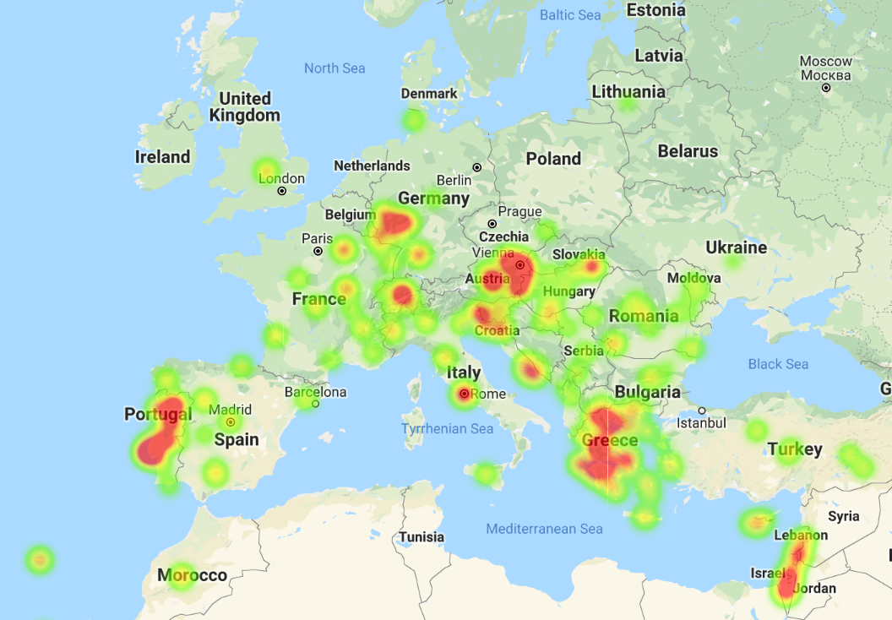
Zoom into Europe
From the heat map we can see that Portugal, Greece and Austria have higher average prices. Also from previous slides, we saw Switzerland, Hungary, and England have the highest average prices.
For our curiosity, we will perform an ANOVA test on the average prices of these countries...

Slide 15
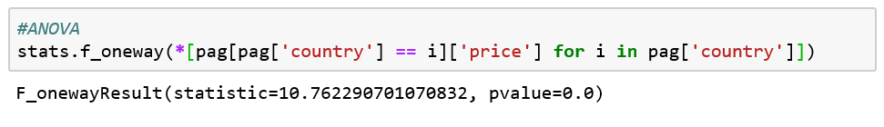
ANOVA Test on Portugal, Greece and Austria’s Average Wine Prices
Ho: These countries’ average wine prices are the same.
Ha: Their average prices are different.
Since p-value is less than 0.05, we conclude that average prices among these countries are significantly different.

Slide 16
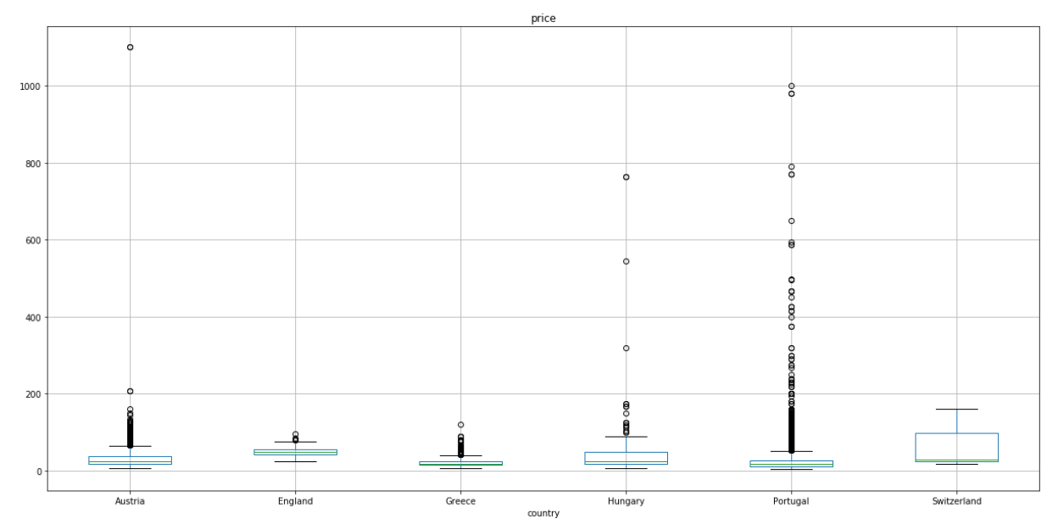
Boxplots of Average Price for European Countries

Slide 17
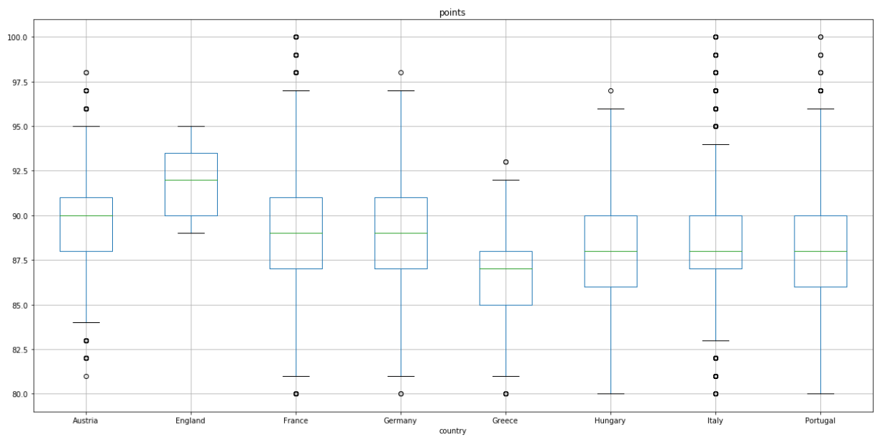
Boxplots of Average Points for European Countries
Majority European countries have 25% wine ratings above 85, and 75% below 94.

Slide 18
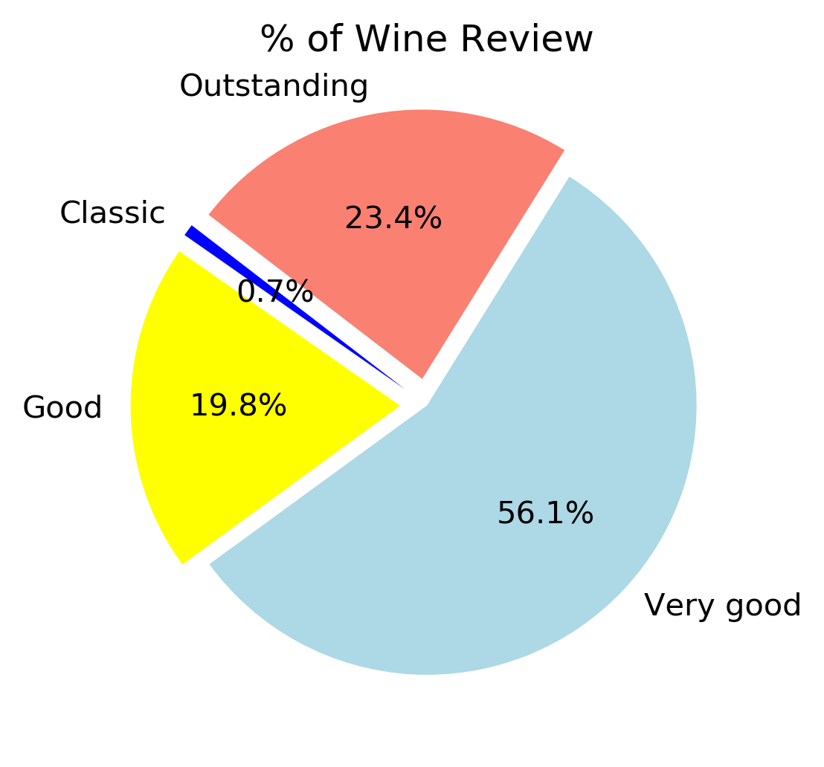
Using the same general point-grouping scale as before, we saw that majority of the wines reviewed were categorized in the “very good” scale.
Let’s see if we can find out why…

Slide 19
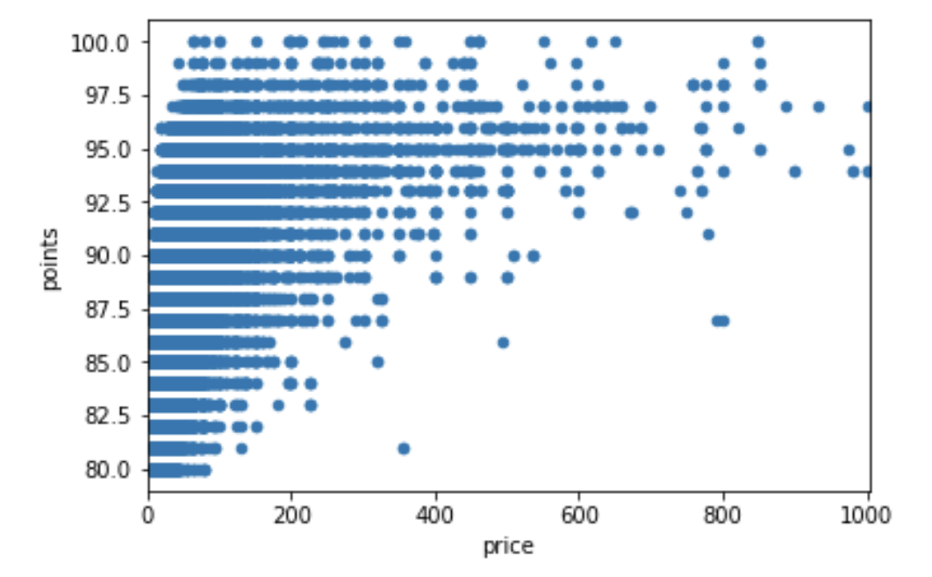
Price vs Points
When displaying point vs price on a scatter plot, we can see in further depth what was displayed in the prior chart. With this more granular view, it is evident that there is a correlation between the price of a wine and the rating it receives; however, we can go further and say lower price point are subject to any rating, while higher price points almost exclusively have higher ratings

Slide 20
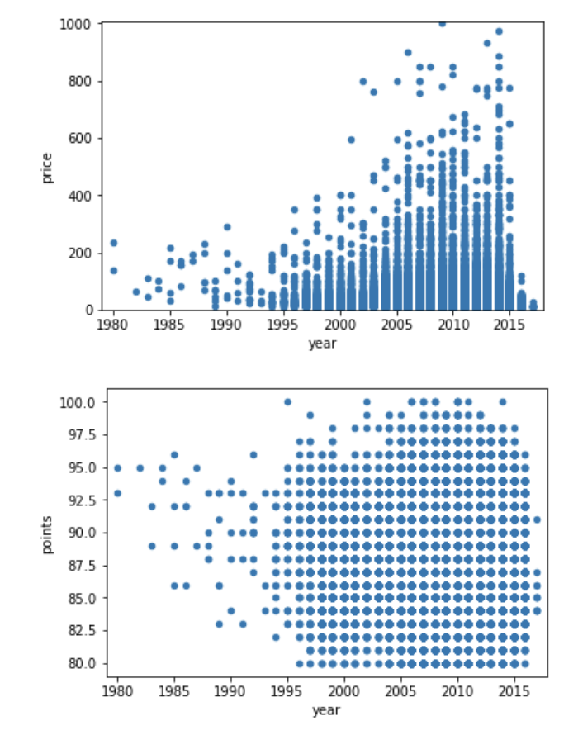
Does Year play any part?
Our initial assumption was that the longer the aging process of wine was, the more expensive the wine would be, and as a result it would receive a higher score.
Our analysis showed the exact opposite.
Newer wines have higher price points than older.
The aging process has absolutely no effect on the rating it receives.

Slide 21
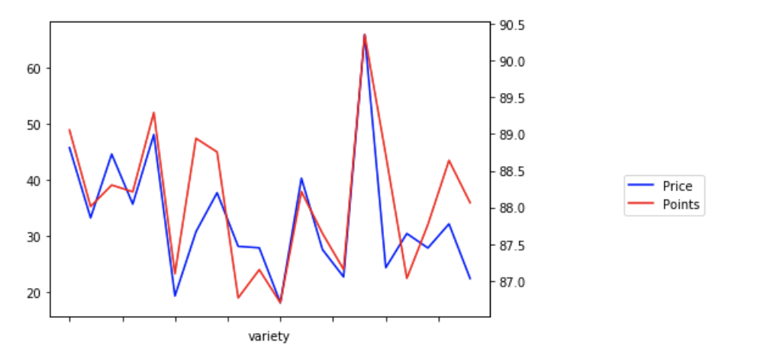
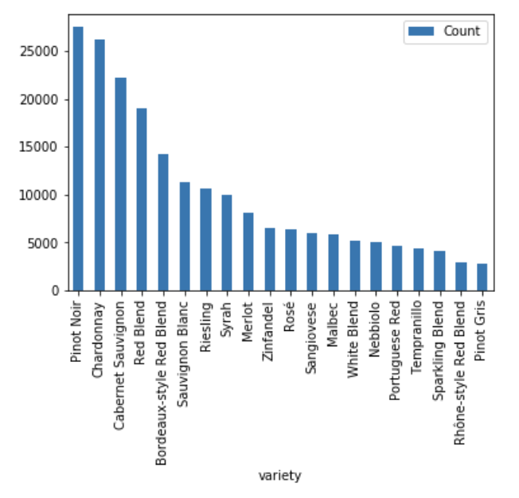
Top 15 Varieties
We took the top 15 varieties by frequency, and plotted price and points against each-other (on different axes) to see if a correlation exists.
In the above chart, we see consistent spikes and dips that seem to have a distinct correlation by variety.
We can conclude that each variety has a fairly consistent price and point rating across.

Slide 22
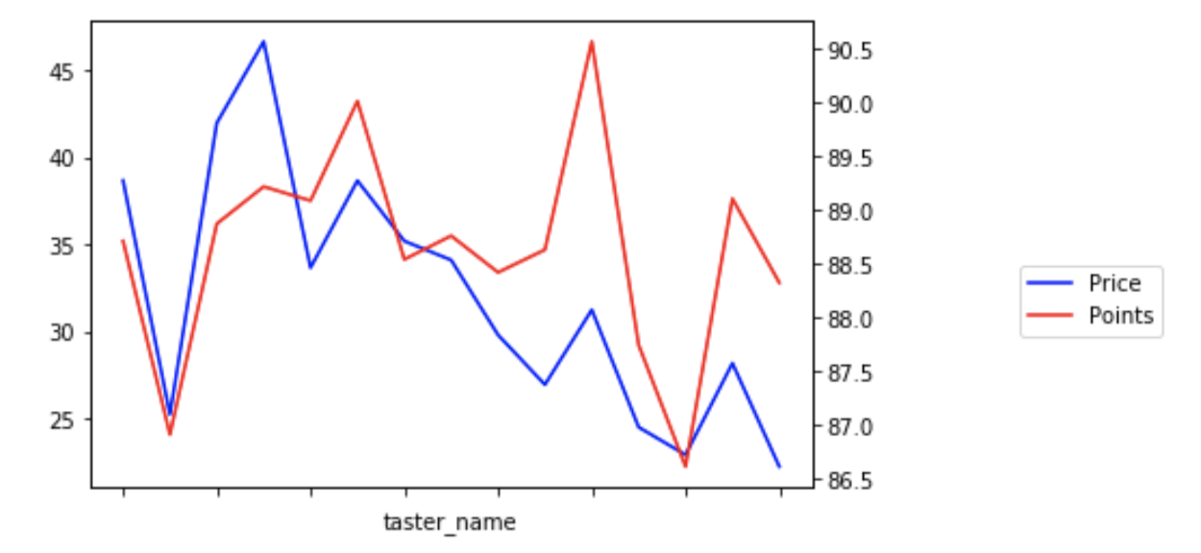
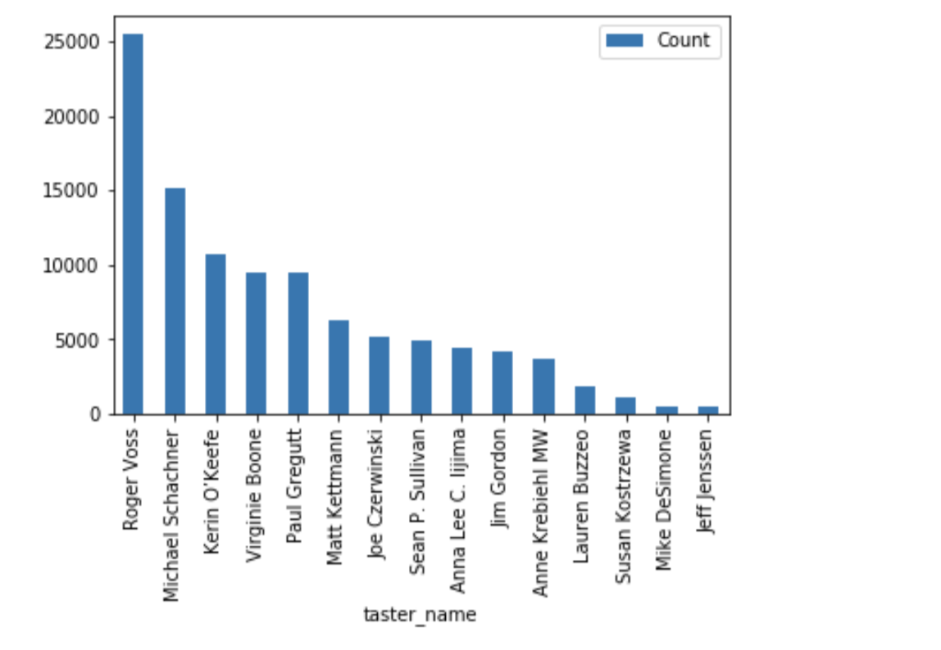
Top Tasters
We performed the same analysis as before on the Professional Tasters that rated the most wines.
The purpose of this analysis was to see if certain tasters rate differently compared to others.
Although there are differences between the gaps in points vs price, generally tasters tend to rate more expensive wines better than cheaper wines.

